Slide 1
Advanced Java Programming
Model-View-Controller

Slide 2
Institute Vision & Mission
Vision
To evolve into a centre of excellence in Science & Technology through creative and innovative practices in teaching - learning, towards promoting academic achievement and research excellence to produce internationally accepted, competitive and world class professionals who are psychologically strong & emotionally balanced imbued with social consciousness & ethical values.
Mission
To provide high quality academic programmes, training activities, research facilities and opportunities supported by continuous industry - institute interaction aimed at promoting employability, entrepreneurship, leadership and research aptitude among students and contribute to the economic and technological development of the region, state and nation.

Slide 3
Department Vision & Mission
Vision
To evolve as a centre of high repute in Computer Science & Engineering and create computer software professionals trained on problem solving skills imbued with ethics to serve the ever evolving and emerging requirements of IT Industry and society at large.
Mission
Imparting quality education through well designed curriculum, innovative teaching and learning methodologies integrated with professional skill development activities to meet the challenges in the career.
Nurture research and consultancy activities amongst students and faculty by providing State-of-art facilities and Industry-Institute Interaction.
· Developing capacity to learn new technologies and apply to solve social and industrial problems to become an entrepreneur.

Slide 4
Contents
What is MVC?
How to implement any application in MVC?

Slide 5
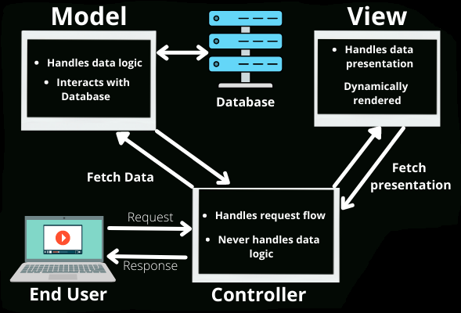
Model-View-Controller
The MVC framework includes the following 3 components: Model, View, Controller.

Slide 6
Model-View-Controller
Example: E-commerce Product Catalogue
Creating an e-commerce product catalogue that displays products with details, allows users to add items to their cart, and proceed to checkout.

Slide 7
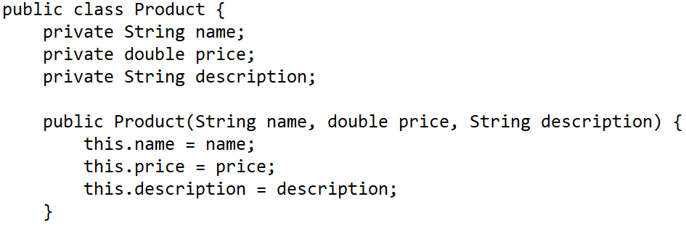
Model-View-Controller
Model

Slide 8
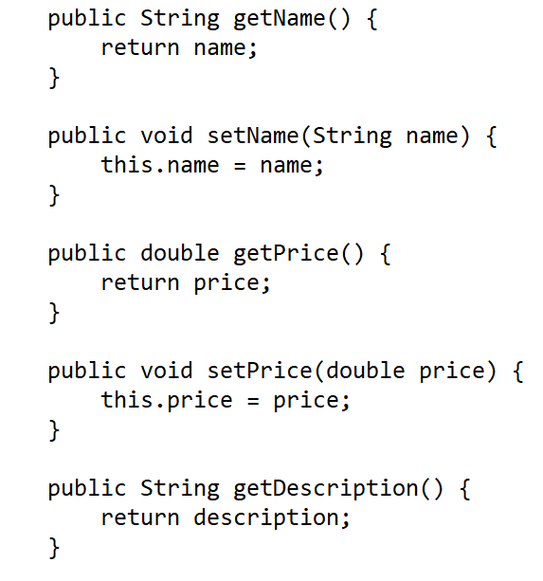
Model-View-Controller
Model

Slide 9
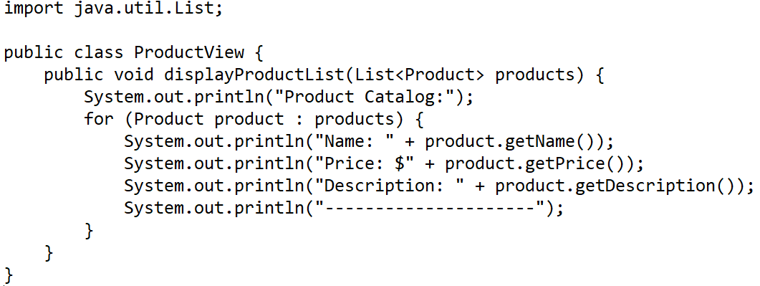
Model-View-Controller
View

Slide 10
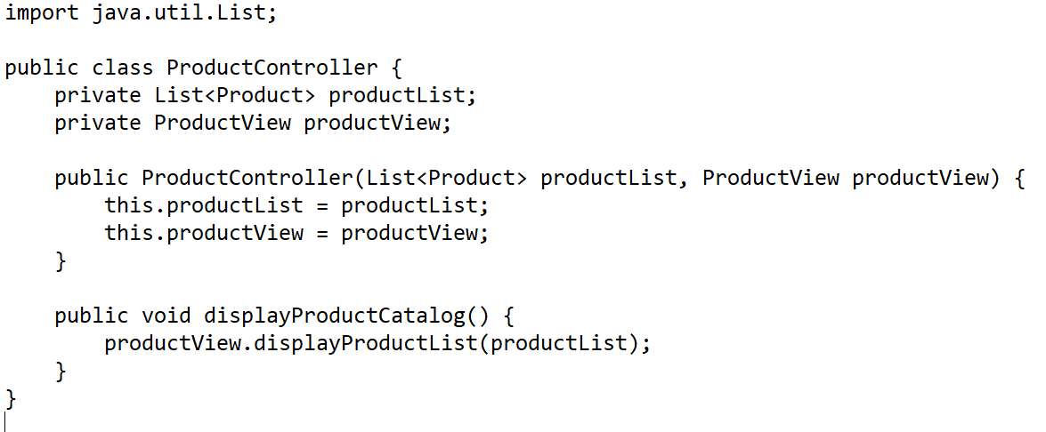
Model-View-Controller
Controller

Slide 11
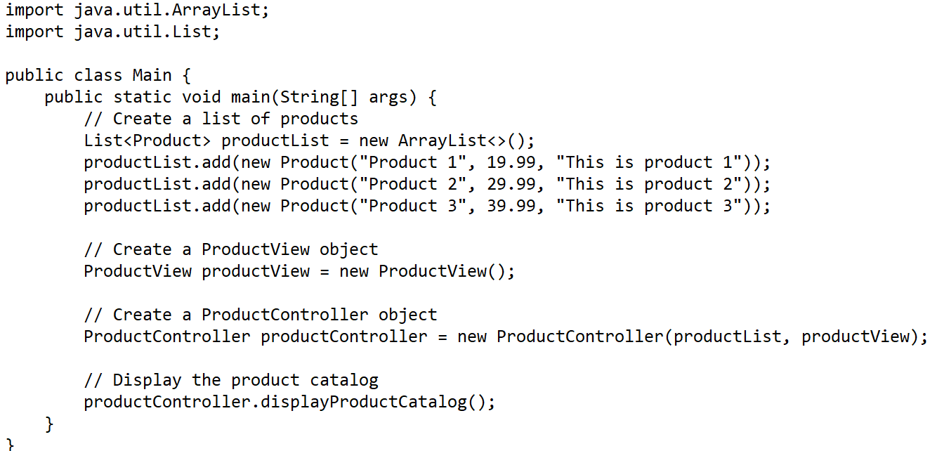
Model-View-Controller
Main

Slide 12
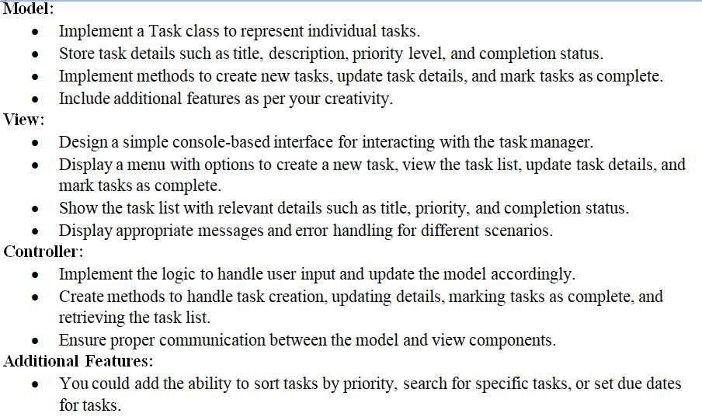
Model-View-Controller
Task 1: Develop a task manager application using the Model-View-Controller (MVC) architecture in Java. The application should allow users to create tasks, assign priorities, mark tasks as complete, and view their task list.

Slide 13
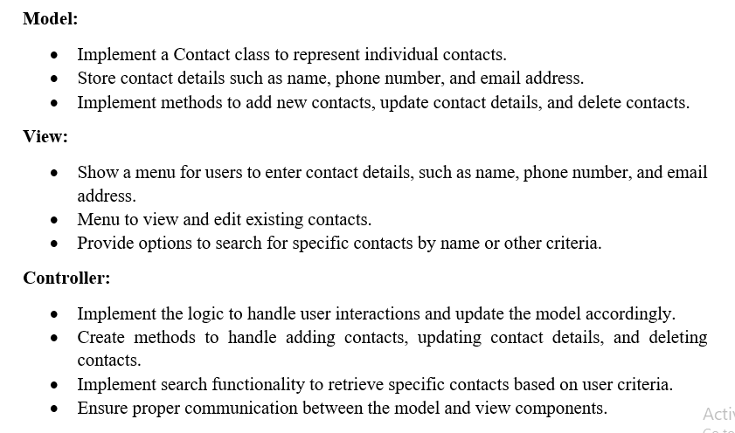
Model-View-Controller
Task 2: Develop an address book application using the Model-View-Controller (MVC) architecture in Java. The application should allow users to store and manage contact information, including names, phone numbers, and email addresses.

